Slide 1
HTML
By,
Nilena Alexander

Slide 2
FRONT END WEB DEVELOPMENT
Creating a graphical interface (front end) for the user to view and interact with data.
The actual implementation of the web design.
HTML(Hypertext Markup Language)-Markup language for creating web pages, contents, the building block and basic structure.
CSS(Cascading Style Sheets)-Describes the pages appearance/presentation.
JavaScript-Programs the behavior of the webpage.

Slide 3
MDN WEB DOCS
MDN Web Docs, previously known as Mozilla Developer Network.
Community-By the Developers, For the Developers, Of the Developers.
Development documentations of Web Standards, Tutorials, References.
Covers HTML, CSS, JS, Web APIs, other development and debugging tools.

Slide 4
BROWSER CONSOLE
Debugging tool for developers, rowser integrated.
Logs information on network requests, js, warnings, messages logged by js code, http requests.
Panels:Elements, Console, Sources, Network, Performance, Memory.
JS FIDDLE:
Tweak html, css, js codes.
Supports Libraries, Frameworks, Tidy up, JSHint.
The code snippets are called as fiddles.
Bookmark, collaborate, version and share your fiddles.

Slide 5
JS BIN:
Hack, Learn, Fix, Teach.
Live Preview.
Snippets are called bins.
CODE PEN:
Utility and Social Network of Front End Developers and Designers.
No proper version tracking and non-collaborative.
PLUNKER:
Multiple files inside the plunk.
Versioning

Slide 6
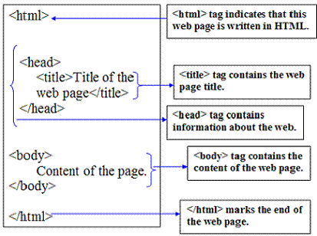
HTML PAGE STRUCTURE

Slide 7
HTML TAGS
HTML tags tells the processing program, often the web browser, what to do with the text.
Basic HTML tags
Formatting tags
Forms and Inputs tags
Audio / Video tags
List and Table tagsUsual HTML Elements: <tag name> content </tag names>.
Tags can have Name, Attributes and Values.
Main Root : <html>.
Document Metadata: <link>, <meta>, <style>, <title>, <script>
Sectioning root: <body>.
Content Sectioning- Logical organisation of Document: Semantic&Header tags.

Slide 8
HTML FORMS
<form>….</form>
<input>, Types( text, number, range, password, file, submit, radio,email...)
Attributes(name, value, readonly, disabled, placeholder, max, min…)
<select> Dropdown
<textarea>
Datalist and Output.

Slide 9
HTML 5
Initial Release in 2014.
Encouraging Semantic (Meaningful) Markup.
Separating Design from Content.
Promoting accessibility and design responsiveness
Reducing the overlap between html, css, js.
Supporting rich media experiences.
Simple <!doctype html>
Custom elements, with the help of css and js (html 5 shiv)
HTML 5 Semantic Elements (header, footer, article, section, nav, aside, figure, main, bdi)

Slide 10
MULTIMEDIA
IMAGES
<figure> and <figurecaption> (HTML 5 only)
<picture> for responsive images
Image maps- with clickable link area.
VIDEO
<video>,<source>, <type>, <track>
Attributes: Height, width, controls, autoplay, preload, muted, loop.
Use <iframe> to embed Youtube content.
AUDIO
<audio> <source> <type> <track>
Attributes: autoplay, preload, muted, loop.

Slide 11
Canvas& svg
CANVAS
Used to draw graphics on a web page, with the help of js.
<canvas>
HTML canvas is used to draw graphics on a web page.
Attributes : width, height
<svg></svg>
SVG is a text based language for describing 2D graphics.

Slide 12
THANK YOU

